Slide 1

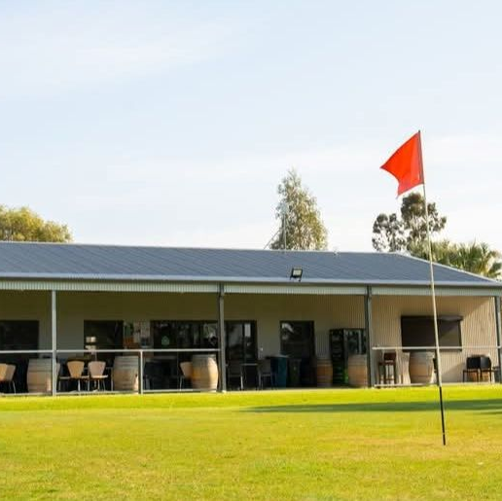
Strategic Plan
2025-2030
Developed in alignment with the Australian Golf Strategy

Slide 2
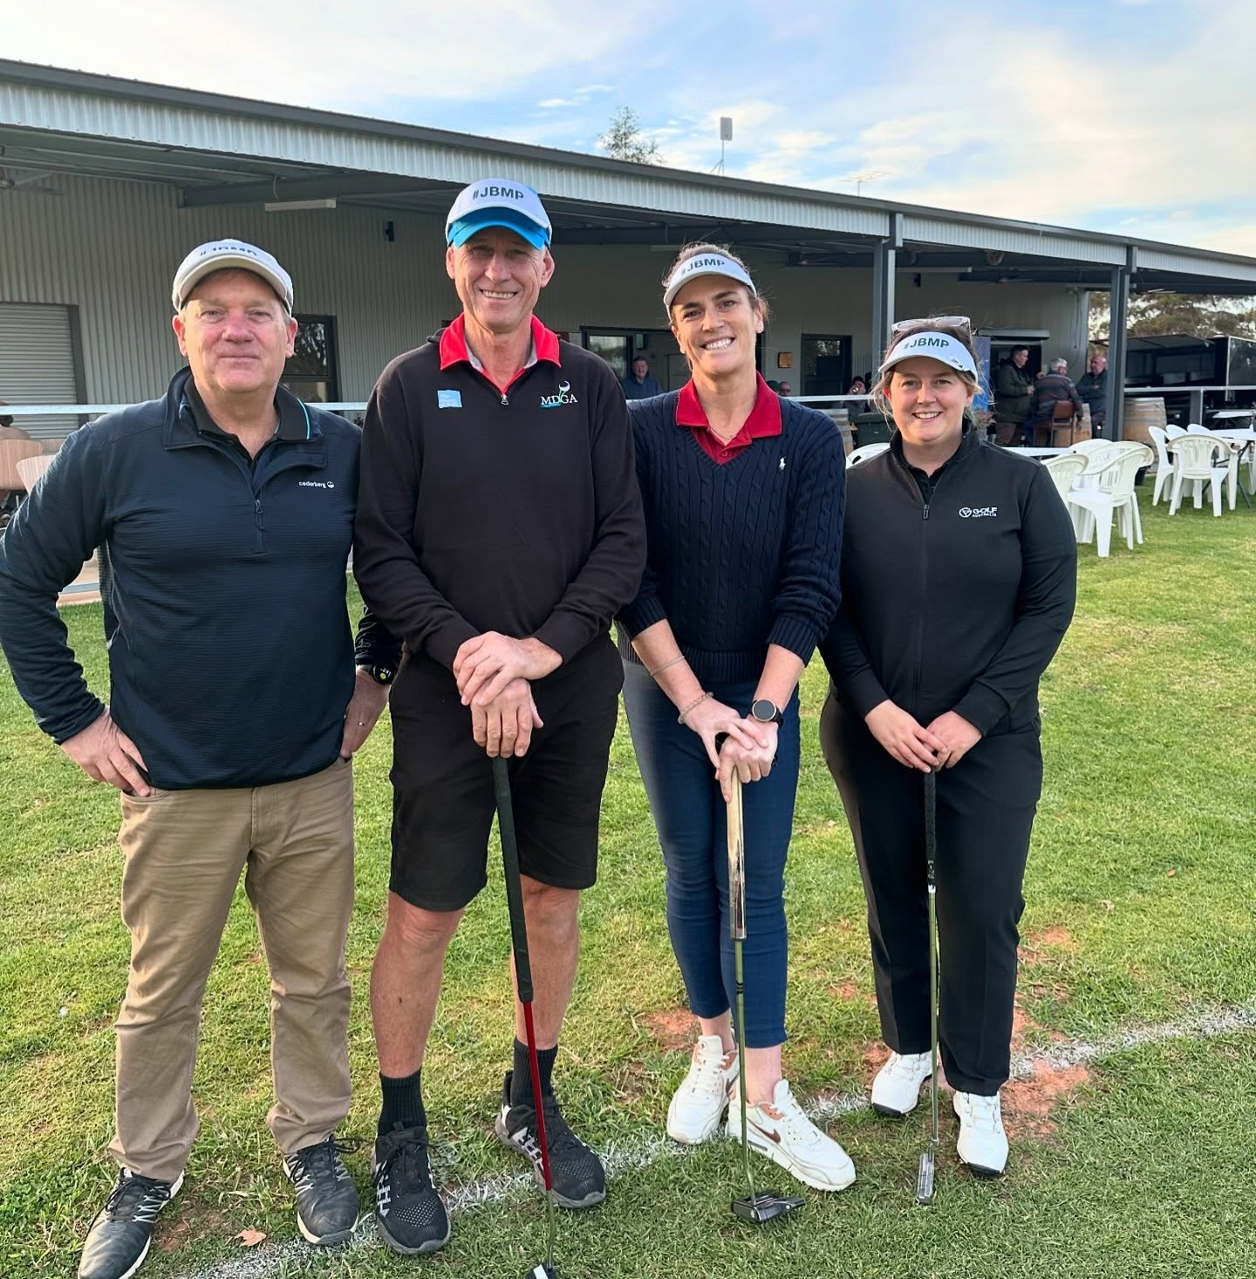
Message from the President
Dear valued Members,
I am thrilled to introduce the Merbein Golf Club's Strategic Plan for the period 2025-2030. This plan is the culmination of hard work and collaboration between the Merbein committee, its members, and Golf Australia’s Victorian Team.
As we look ahead to the next five years, it is clear the golf industry in Australia is evolving rapidly, with new technologies, changing demographics, and shifting expectations from members and customers. To stay competitive and ensure that golf remains a vibrant and thriving sport, it is essential that the Merbein Golf Club is proactive in planning for the future.
This Strategic Plan is designed to do that. It aligns with the "Strategy for Australian Golf," which aims to make golf more accessible, welcoming, and enjoyable for all Australians. At the same time, it addresses the unique needs and challenges facing the Merbein Golf Club specifically, considering the feedback of members, our culture, and values.
The plan lays out a clear vision for the future of the Merbein Golf Club, with specific goals and objectives that will guide our decision-making and operations over the strategy period. It covers areas such as participation and membership growth, course maintenance and upgrades, financial sustainability, and community engagement.
I am confident that this Strategic Plan will set the Merbein Golf Club on a successful path, both in the short and long term. I would like to thank everyone who contributed to its development, including the Golf Australia team, the Merbein committee, our members, and stakeholders.
I invite you all to read the plan and join us on this exciting journey towards a bright future for the Merbein Golf Club.
John Bell
President
Merbein Golf Club

Slide 3

Strategy for Merbein Golf Club
2025-2030
v
Our Purpose
More Australians playing more golf
Our Philosophy
All golf is golf and all of us can be golfers
Our Positioning
A sport for life
and fun for all
v
 | TELL OUR STORY BETTER | ATTRACT NEW GOLFERS | GROW OUR CORE | ATTRACT NEW FANS AND GROW REVENUE | WORK TOGETHER
AMBITION | We are a valued, accessible community facility, known for our relaxed, friendly and welcoming environment. | We are the recreational entertainment facility of choice for Merbein & Cabarita | Our growing membership and workforce are engaged and representative of the community. | We have a loyal customer base who advocate for our facility, and we strategically invest in our future. | We are a respected local partner known for our focus on collaboration and commitment to mutual benefit.
WHAT IS SUCCESS | Increased awareness of our facility which supports strategic community engagement | An increase in new participants and returning golfers using our facilities | Effective member attraction / retention supporting membership growth | Growing sustainable revenue and profits | Growth in community and commercial partnerships along with a productive government relationships.
WHAT WILL WE DO | Increase our digital presence to reach a broader audience and improve communication across all platforms | Provide a great customer experience to encourage return visitation | Implement an ongoing membership retention plan to increase our understanding of member needs | Modernise all areas of our operations to maximise revenue and invest in the future of our club | Work with key stakeholders and other organisations to develop meaningful partnerships

Slide 4




Slide 5
Our pillars
Tell our story better
Attract new participants
Grow our core
Attract new fans and grow revenue
Work together

Slide 6
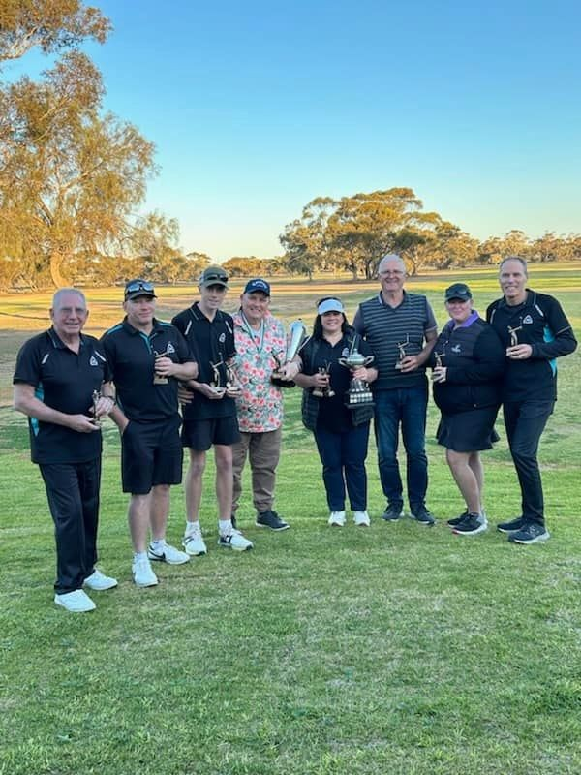
Tell our story better
Our ambition:
We are a valued, accessible community facility, known for our relaxed, friendly and welcoming environment.
Success will be measured by
Social media engagement across all platforms.
Website functionality, visitation and utilisation.
Visitation metrics, new and returning visitors across all offerings
To achieve this, we will
Utilise social media engagement data, expand our platforms to reach new audiences and develop content to target specific demographics.
Develop a user-friendly website with current and relevant content to attract new users to the facility and provide new revenue opportunities (online bookings and reservations)
Capture visitor data to create opportunities for feedback, targeted marketing and member benefits
Review our current communication and promotional practices to develop a communication and promotional plan for both internal and external stakeholders.

Slide 7
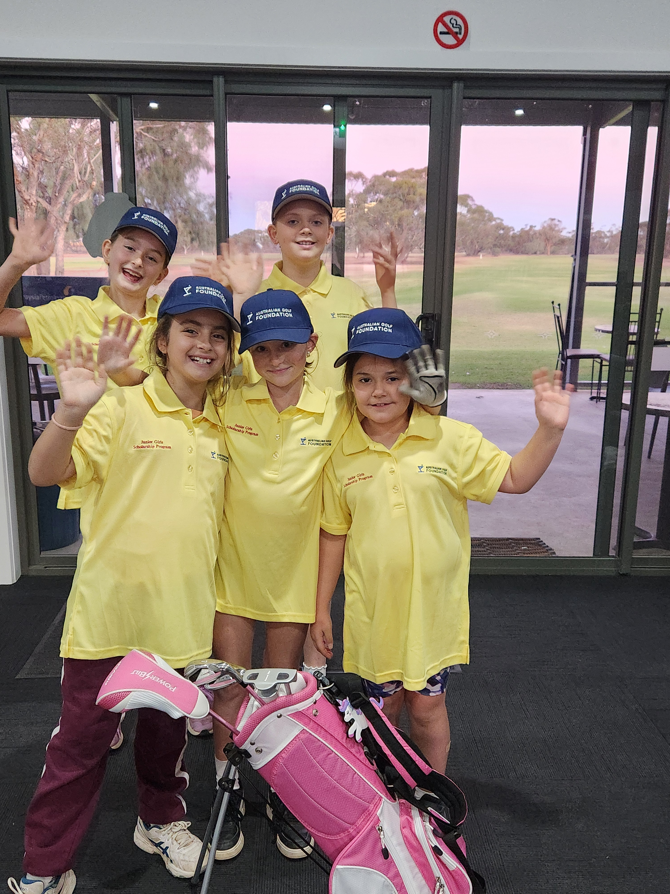
Attract new golfers
Our ambition
We are the recreational entertainment facility of choice in Merbein and the Cabarita area
Success will be measured by
Introductory clinic attendance and retention of participants that focus on adults aged 20-40 and children under 18.
Social rounds played
Participant survey NPS and insights.
To achieve this, we will
Develop and document a participation plan including, community activations, introductory programs, social activities and a pathway to membership.
Improved data collection to identify opportunities to increase facility usage and track new and returning visitors.
Activate an ongoing guest survey using feedback to implement appropriate actions to improve the customer experience and encourage return visitation.
Develop relationships with schools in the area to promote the benefits of golf.

Slide 8
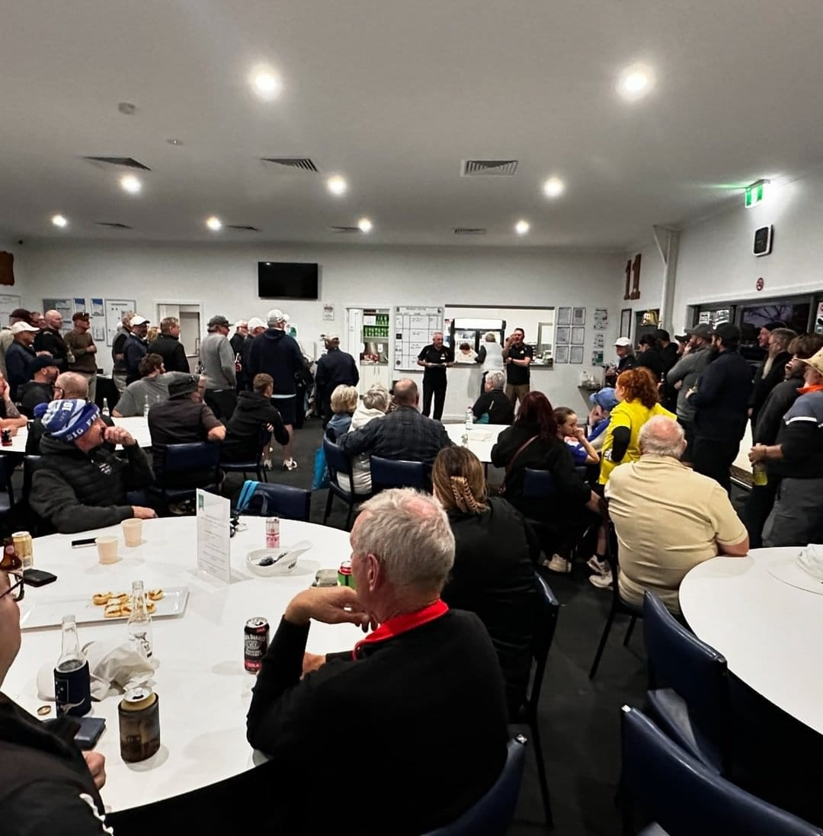
Grow our core
Our ambition:
Our growing membership and workforce are engaged and representative of the community.
Success will be measured by
Membership metrics: attraction, retention, percentages and total across all demographics.
Rounds played across all membership categories.
Governance practices that reflect a modern, professional organisation.
Member survey NPS and insights.
Workforce diversity and demographics
To achieve this, we will
Implement a member attraction/retention plan, including a focus on increasing female numbers, a younger demographic and pathways to membership.
Explore potential participation options to provide more variety for members.
Employ the ASC governance principles to drive a best practice, values driven approach.
Annual membership survey to monitor member sentiments
Re-imagine volunteer offerings and plan for future paid workforce requirements.

Slide 9
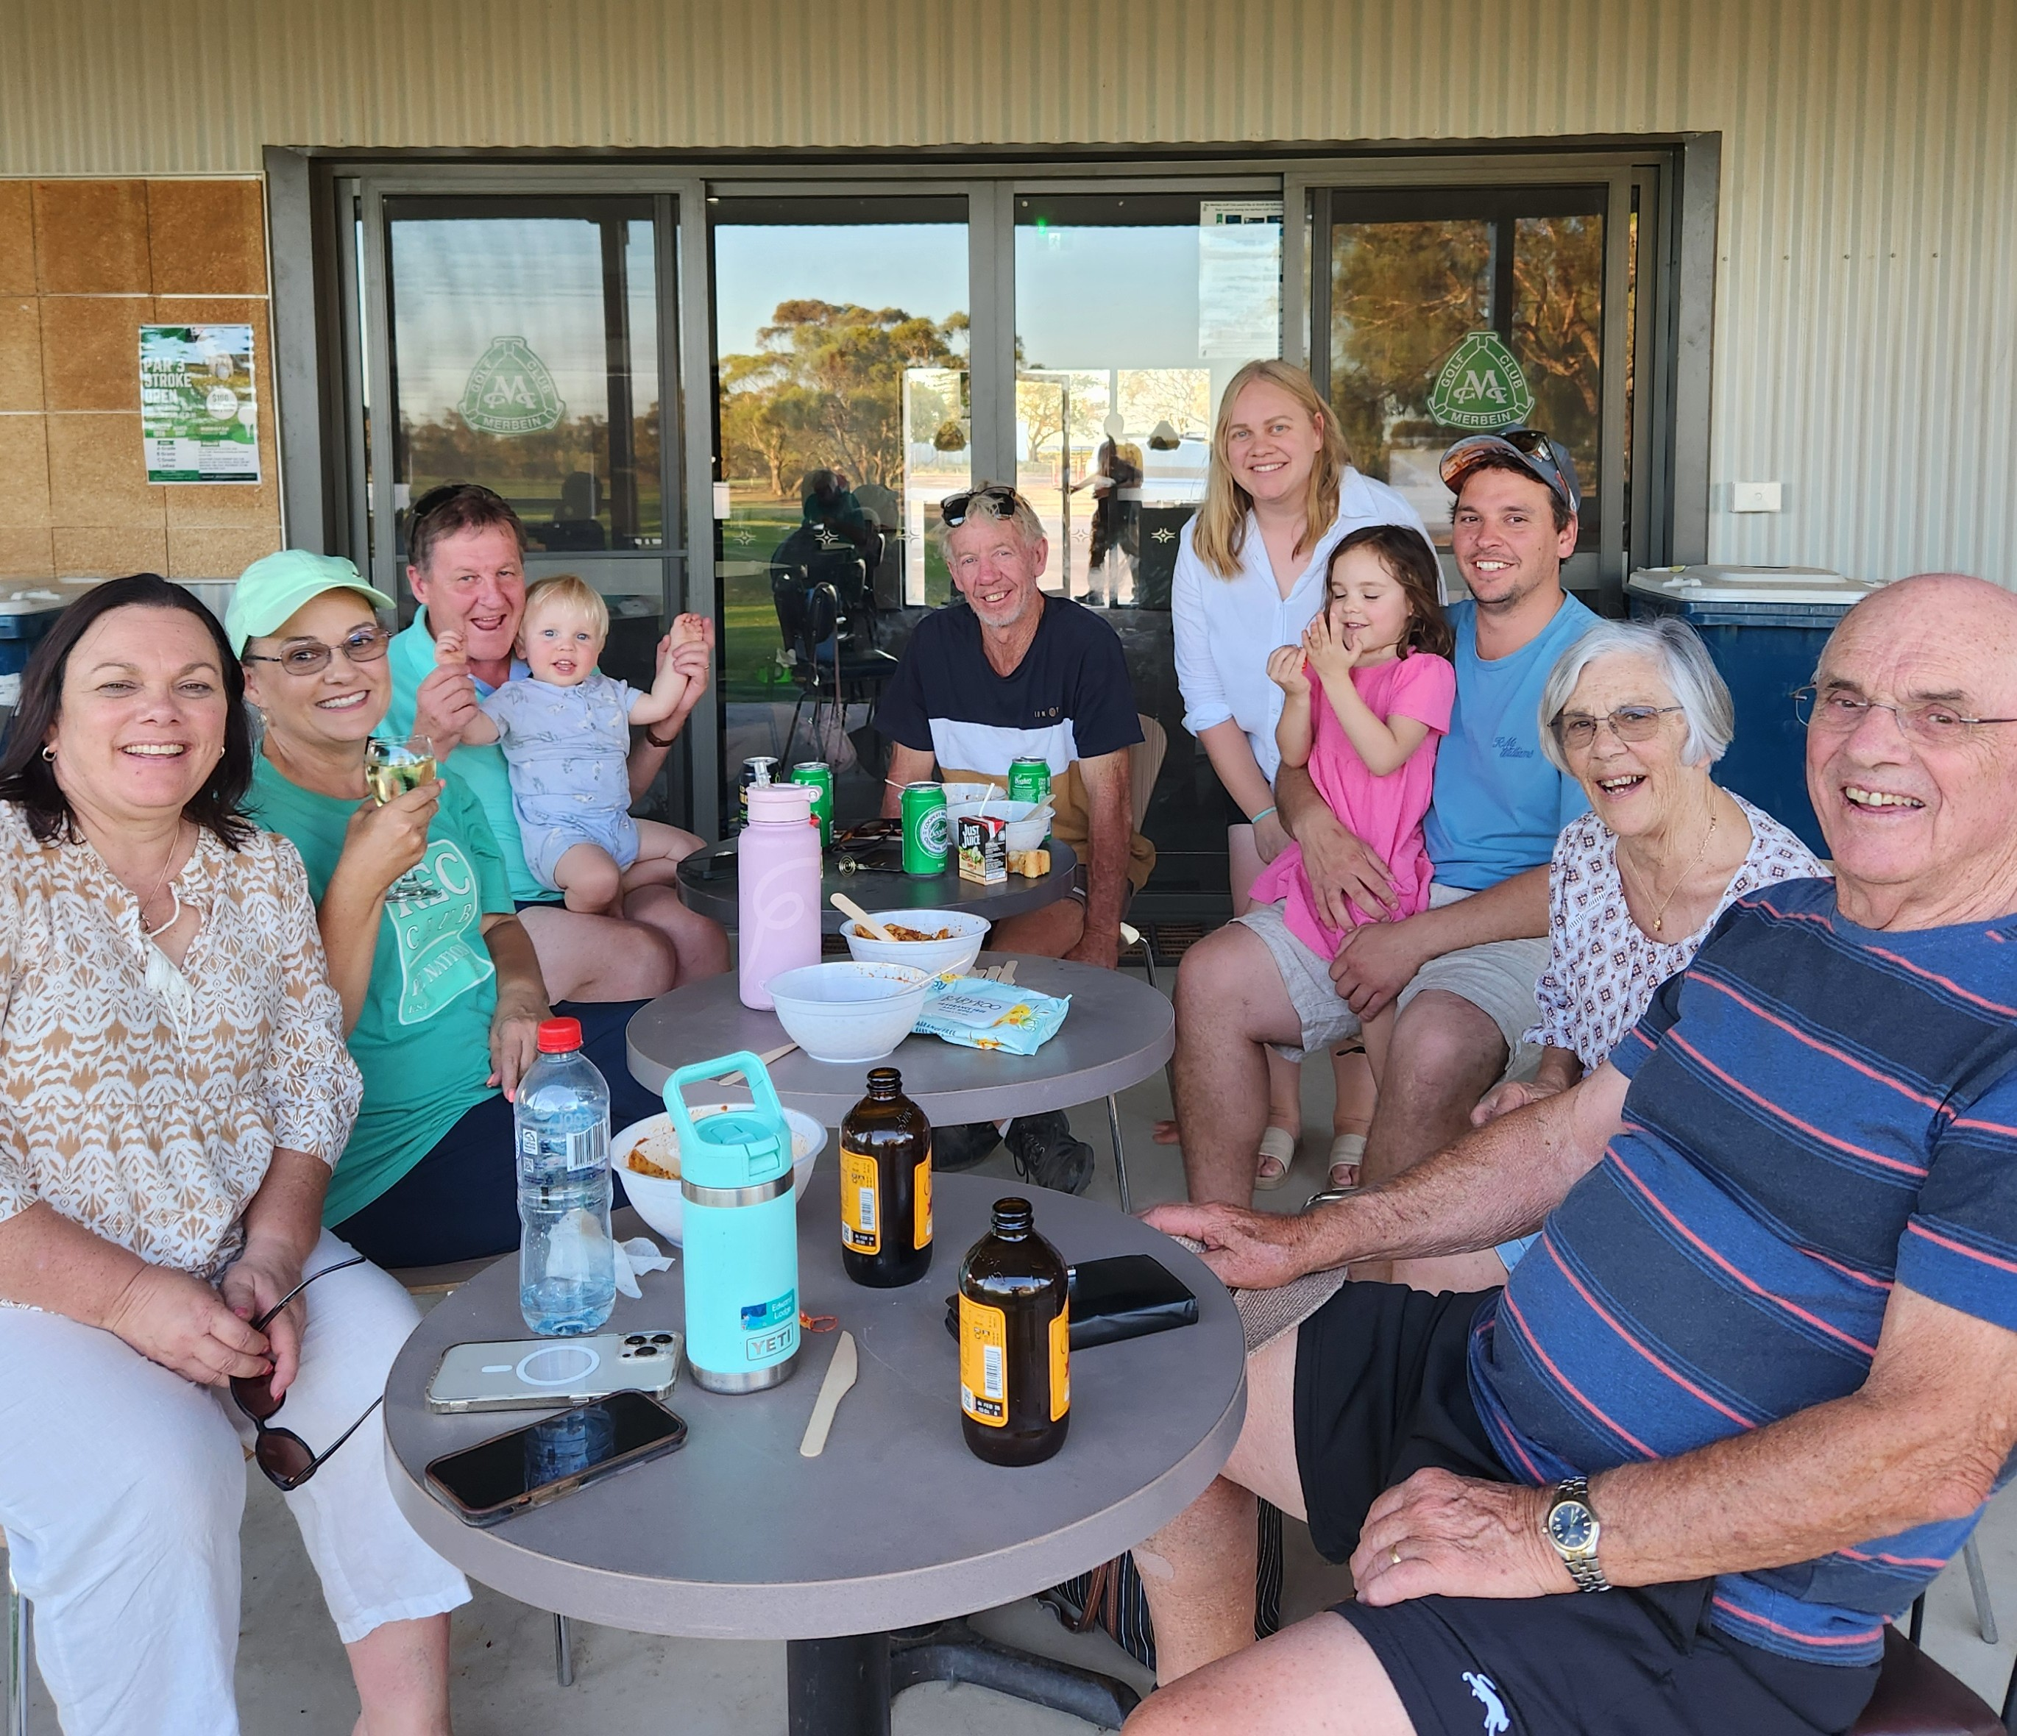
Attract new fans and grow revenue
Our ambition:
We have a loyal customer base who advocate for our facility, and we strategically invest in our future.
Success will be measured by
Financial performance: Earnings before Interest, Taxes, Depreciation and Amortisation (EBITDA), asset value.
Diversified revenue sources, i.e. Member, Non-member, Facilities, Sponsorship & Other external opportunities.
To achieve this, we will
Budget for 15% minimum EBITDA and be disciplined.
Review management systems to modernise booking/payment processes and maximise potential revenue generation.
Investigate online public booking capability for the golf course
Review the relevance, pricing and entitlements of current membership categories.

Slide 10
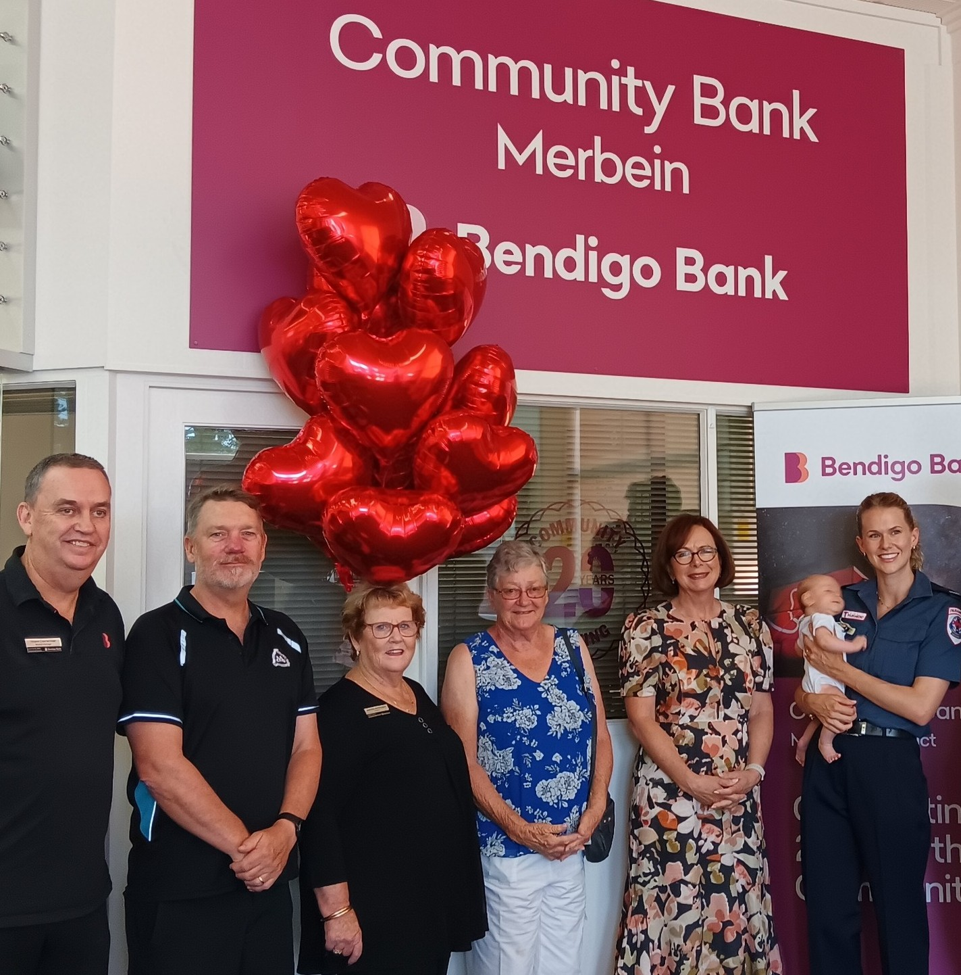
Work together
Our ambition:
We are a respected local partner known for our focus on collaboration and commitment to mutual benefit.
Success will be measured by
Partnership metrics (Number of partnerships their engagement and outcomes).
Progress against strategic plan.
Relationship with the Rural City of Mildura and DECA.
To achieve this, we will
Develop and nurture partnerships with local businesses, schools and sporting clubs (golf and other).
Report regularly and consistently on the strategic plan.
Develop a working relationship with the Rural City of Mildura to achieve strategic objectives through initiatives beneficial to the council, club, wider municipal catchment.

Slide 11
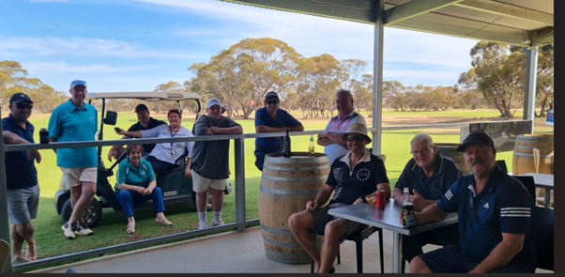
The Merbein Golf Club thanks all the contributors to the development of this Strategic Plan
Merbein Golf Club
John Bell
Melinda Binding
Michael Thompson
Graeme Kelly
Graeme Kerr
Graeme Dunne
Alan Gourlay
Golf Australia
Tahlia Addlem
Mark Bamford

Slide 12


